Slide 1
Code Reuse & Documentation

Slide 2


Slide 3
What ?
Code reuse is the practice of using existing code for a new function or software
Code reusability defines the methodology you can use to use similar code, without having to re-write it
E.g Open Source Lib

Slide 4
When ?
Easily extended and adapted for the new application
Ported to different hardware if needed
Code is free from defects or problems that affect the reliability, safety, or security of the new application

Slide 5
Advantages
Less effort: Software reuse requires less effort because many components use in the system are ready made components.
Time-saving: Re-using the ready made components is time saving for the software team.
Reduce cost: Less effort, and time saving leads to the overall cost reduction.
Increase software productivity: when you are provided with ready made components, then you can focus on the new components that are not available just like ready made components.

Slide 6
Utilize fewer resources: Software reuse save many sources just like effort, time, money etc.
Leads to a better quality software: Software reuse save our time and we can consume our more time on maintaining software quality and assurance.

Slide 7
Commercial-off-the-shelf and Commercial-off-the-shelf components?
Commercial-off-the-shelf is ready-made software.
Commercial-off-the-shelf software components are ready-made components that can be reused for a new software.

Slide 8
Approaches
Inheritance
use the base class's functions and members in other classes
Similar functions are reused
Function calls
create small code blocks of an algorithm or logic-based source code
ensure that every logic is written once

Slide 9
Libraries
Dynamic Link Libraries (DLL)
a set of compiled programs
libraries can be linked to your executable code
framework allows support of using and creating third-party libraries
Forking (Github)
forking is a process of using someone else's source code and making changes to it to fit your own needs
Component based design

Slide 10
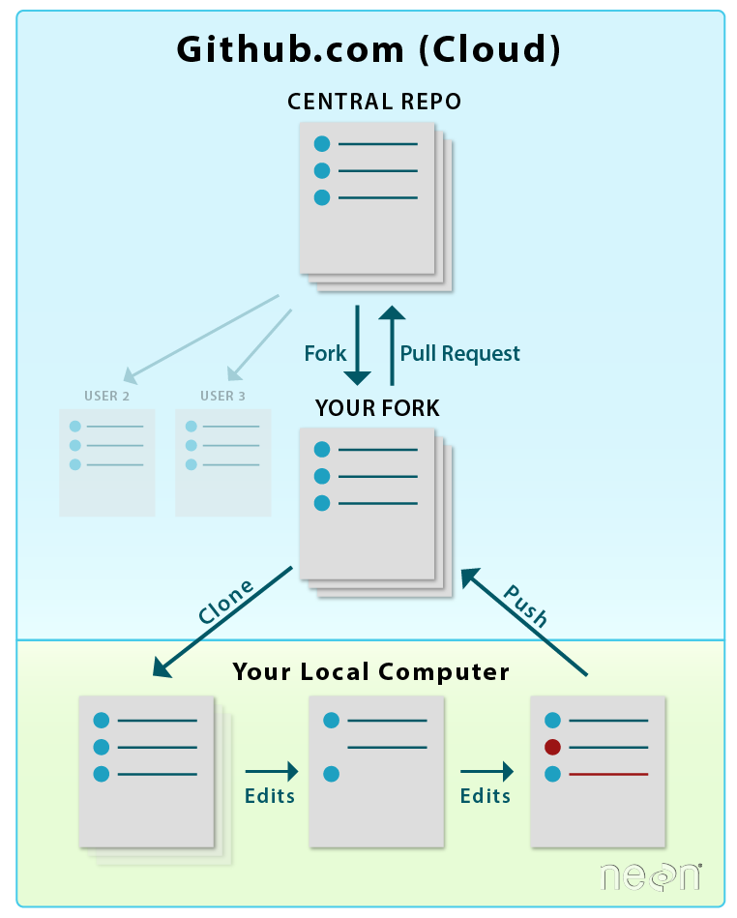

Slide 11
Stages of reuse-oriented software engineering?
Requirement specification: First of all, specify the requirements. This will help to decide that we have some existing software components for the development of software or not.
Component analysis: Helps to decide that which component can be reused where.
Requirement updations / modifications: If the requirements are changed by the customer, then still existing components are helpful for reuse or not.

Slide 12
Reuse System design: If the requirements are changed by the customer, then still existing system designs are helpful for reuse or not.
Development: Existing components are matching with new software or not.
Integration: Can we integrate the new systems with existing components?
System validation: To validate the system that it can be accepted by the customer or not.

Slide 13
Documentation
Documentation is the information that describes the product to its users
consists of the product technical manuals and online information
Earlier programmers and developers were doing documentation but no technical writers are required

Slide 14
Types
System Documentation
requirements document
software architecture documentation or design document
source code document
quality assurance documentation
User Documentation
release notes and installation guides
training manuals
user manuals
Online help

Slide 15
User Manual Vs Training Manual
A user manual generally is used by our customers to find out what features/functions are available and how to use them. generally, user manuals explain each screen and field.
A training manual is written a bit different and may have exercises for the user to complete. Training manuals are often given out when a customer attends a training session. Also, there is usually room to make notes, etc. A training manual walks the user through specific part of the system, step-by-step, but may not explain all of the functionality/features of the system. Training manuals traditionally contain more screen shots of the application.

Slide 16
Documentation Standards
Documentation standards are rules and guidelines for creating, formatting, revising all documents on behalf of an organization
IEEE standards for system documentation and user documentation

Slide 17
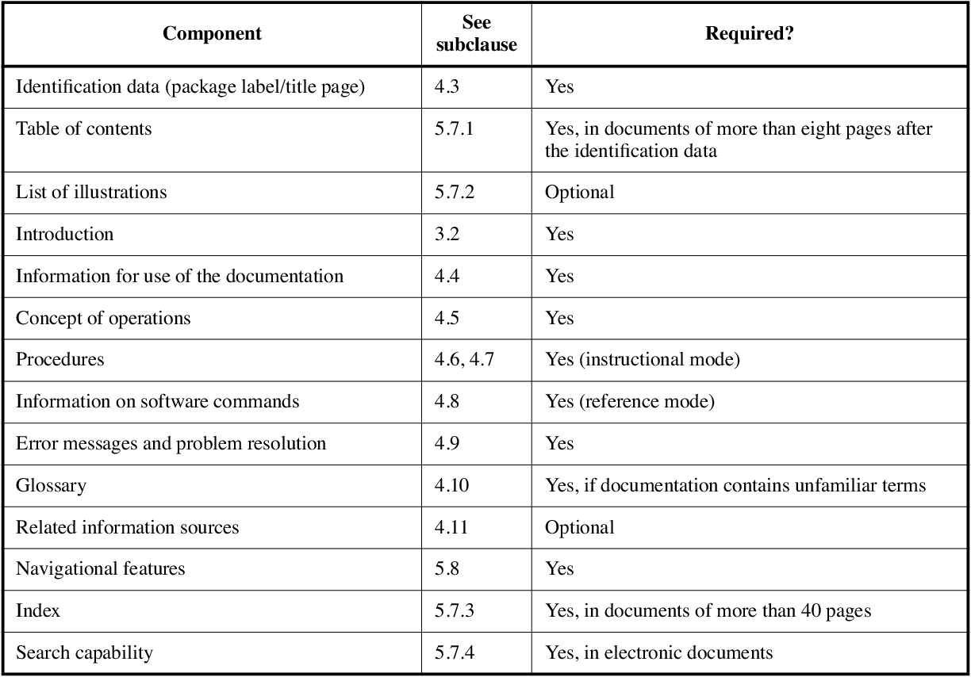

Slide 18
Go through the IEEE-standard-for-user documentation PDF

